Slide 1


@RLadiesAU
Building a Shiny App
22th November 2017
Marie Trussart
Soroor Zadeh

Slide 2


Hello!
We are Marie Trussart
Soroor Zadeh
Welcome to Introduction to R Shiny!

Slide 3
What we will cover
What is Shiny and why using it?
Official Shiny Gallery
How to build a Shiny app?
First exercise: Build your first Shiny app
Second exercise: Add some Inputs/Outputs to your app
Reactive expressions
R Shiny server
Third exercise: Add reactivity to your app

Slide 4
Software needed to Build Shiny APP
Recent version of R (from 3.3.x but latest is recommended)
Recent version of Rstudio
Three R packages:
install.packages(“ggplot2”)
install.packages(“rmarkdown”)
install.packages(“shiny”)
library(“ggplot2”)
library(“rmarkdown”)
library(“shiny”)

Slide 5
What is Shiny and why using it?
Shiny is an R package to build interactive web apps from R.
You can host standalone apps on a webpage or embed them in R Markdown.
It is easy to learn and does not require knowledge of html, javascript or other web technologies.
It is integrated in Rstudio for easy development and debugging.
All written in R, it extends all R packages and R tools to a web development framework!

Slide 6
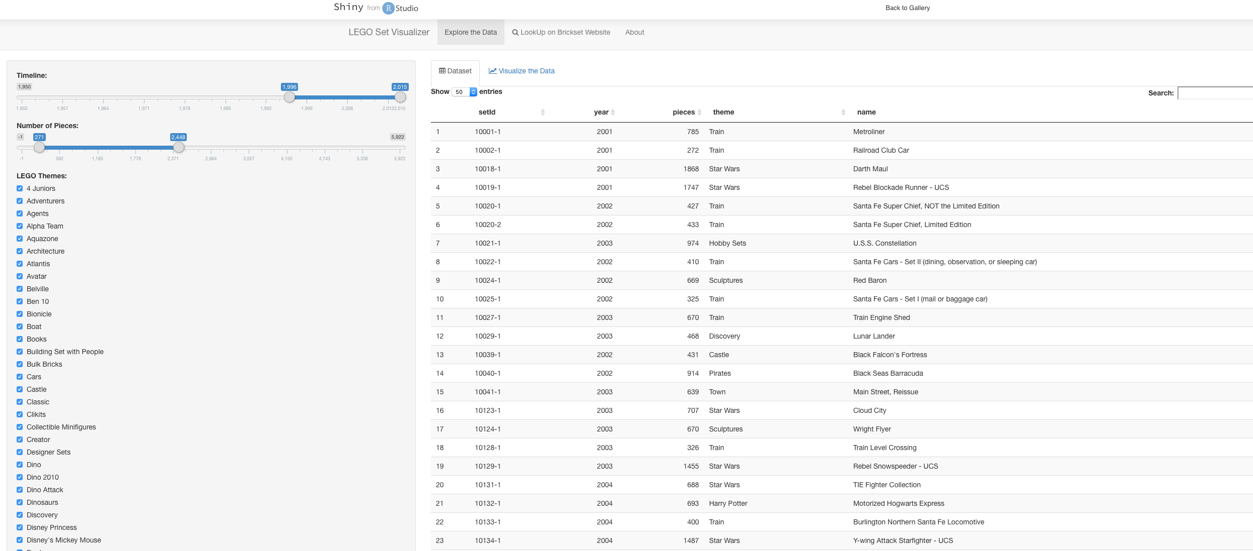
Here is a shiny app

Slide 7
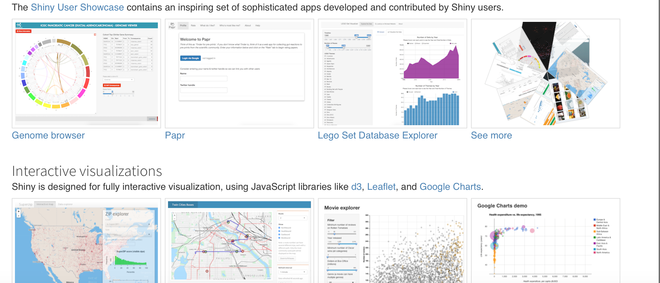
Official Shiny Gallery
http://shiny.rstudio.com/gallery/

Slide 8
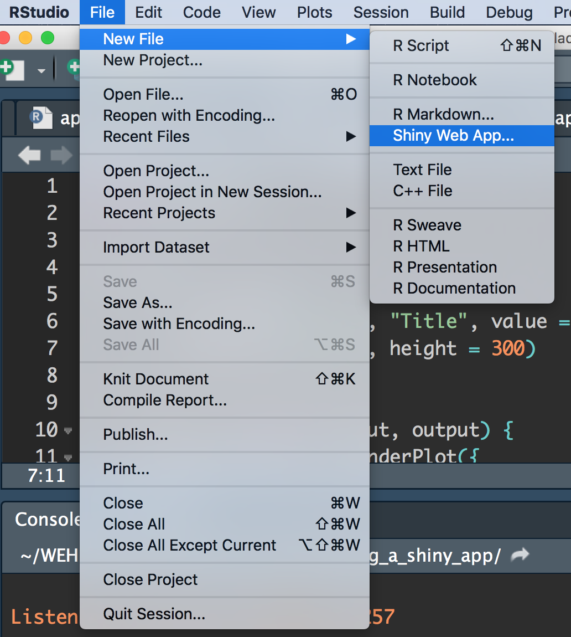
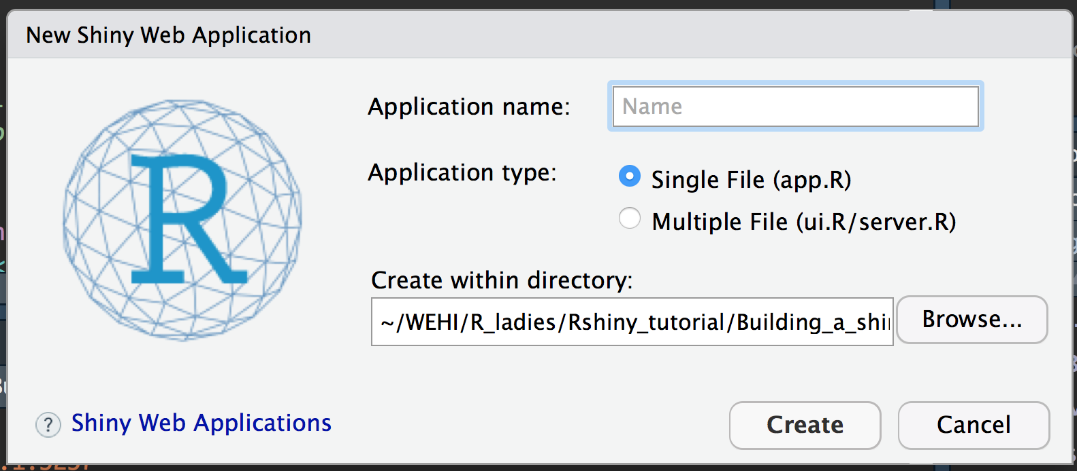
How to create a Shiny app?

Slide 9
What is the structure of a Shiny app?
The User Interface (UI) definition
It defines the appearance of the app
Lists input and output and where they will appear
DO NOT CONTAIN R-ANALYSIS CODE

Slide 10
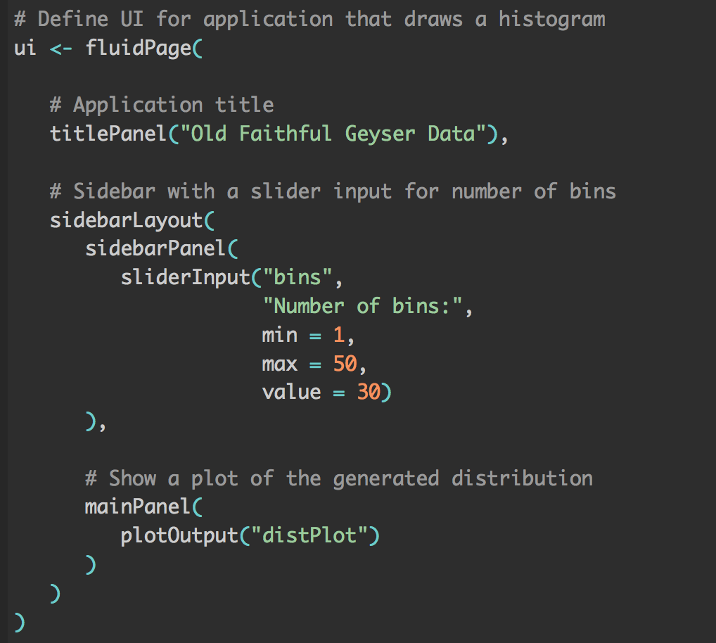
THE USER INTERFACE: WHAT YOU WANT TO DISPLAY

Slide 11
What is the structure of a Shiny app?
The User Interface (UI) definition
It defines the appearance of the app
Lists input and output and where they will appear
DO NOT CONTAIN R-ANALYSIS CODE
The Server definition
It defines the functionality of the app
It contains the code of the R analysis scripts to produce the results that will be output!

Slide 12
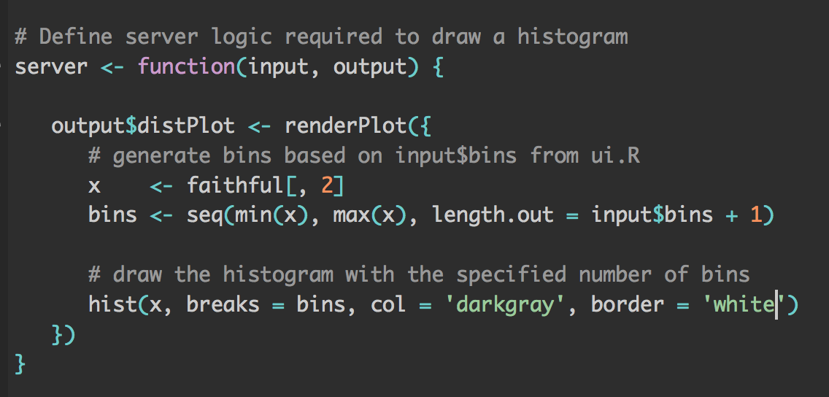
THE SERVER: HOW TO DISPLAY

Slide 13
What is the structure of a Shiny app?
The User Interface (UI) definition
It defines the appearance of the app
Lists input and output and where they will appear
DO NOT CONTAIN R-ANALYSIS CODE
The Server definition
It defines the functionality of the app
It contains the code of the R analysis scripts to produce the results that will be output!
A call to the shinyApp function

Slide 14
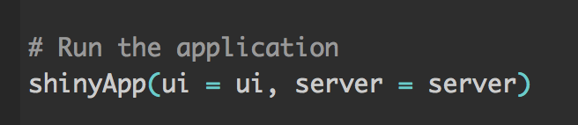
A call to the shiny app function

Slide 15
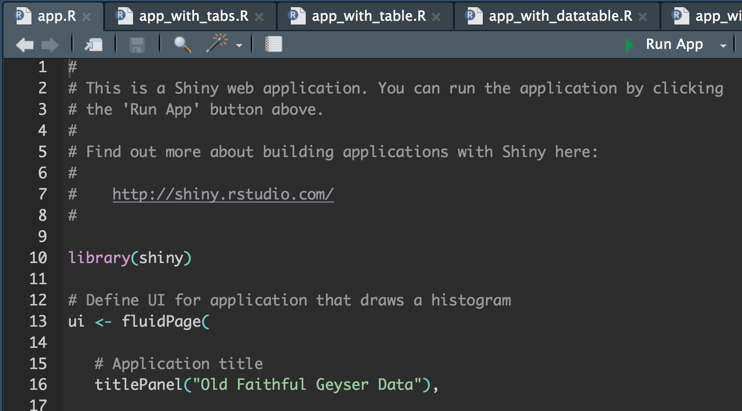
How to run a Shiny app?

Slide 16
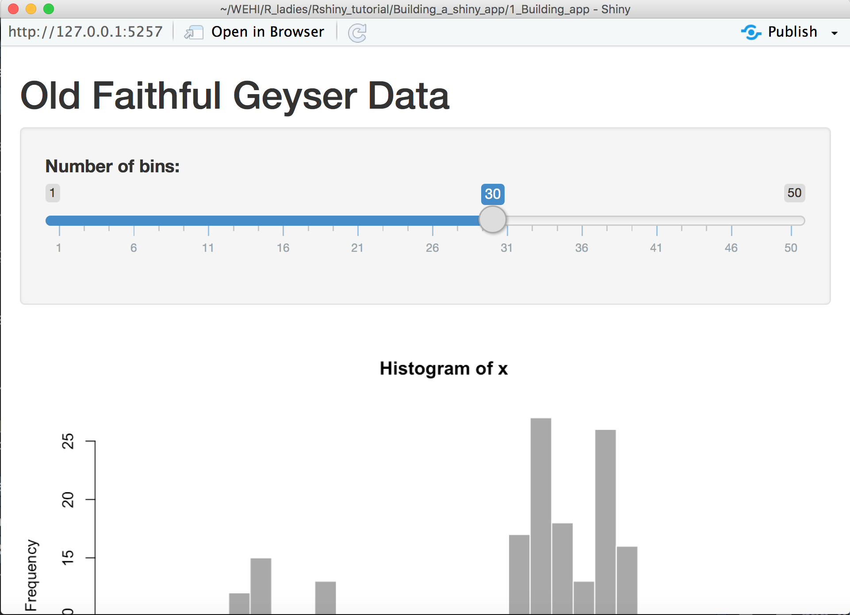
How to create a Shiny app?

Slide 17
First exercise: create your own app
Modify the application to plot the distribution of Rladies Melbourne members attendance:
Change the title of the panel to: " R-ladies members attendance to events”.
Change the maximum number of bins to 16.
Change the default bin value to 8.
Load a different dataset to plot the distribution Members attendance to Meetups (file to load is: Members_attendance.txt)
Change the color of the histogram to blue and border to lightblue

Slide 18
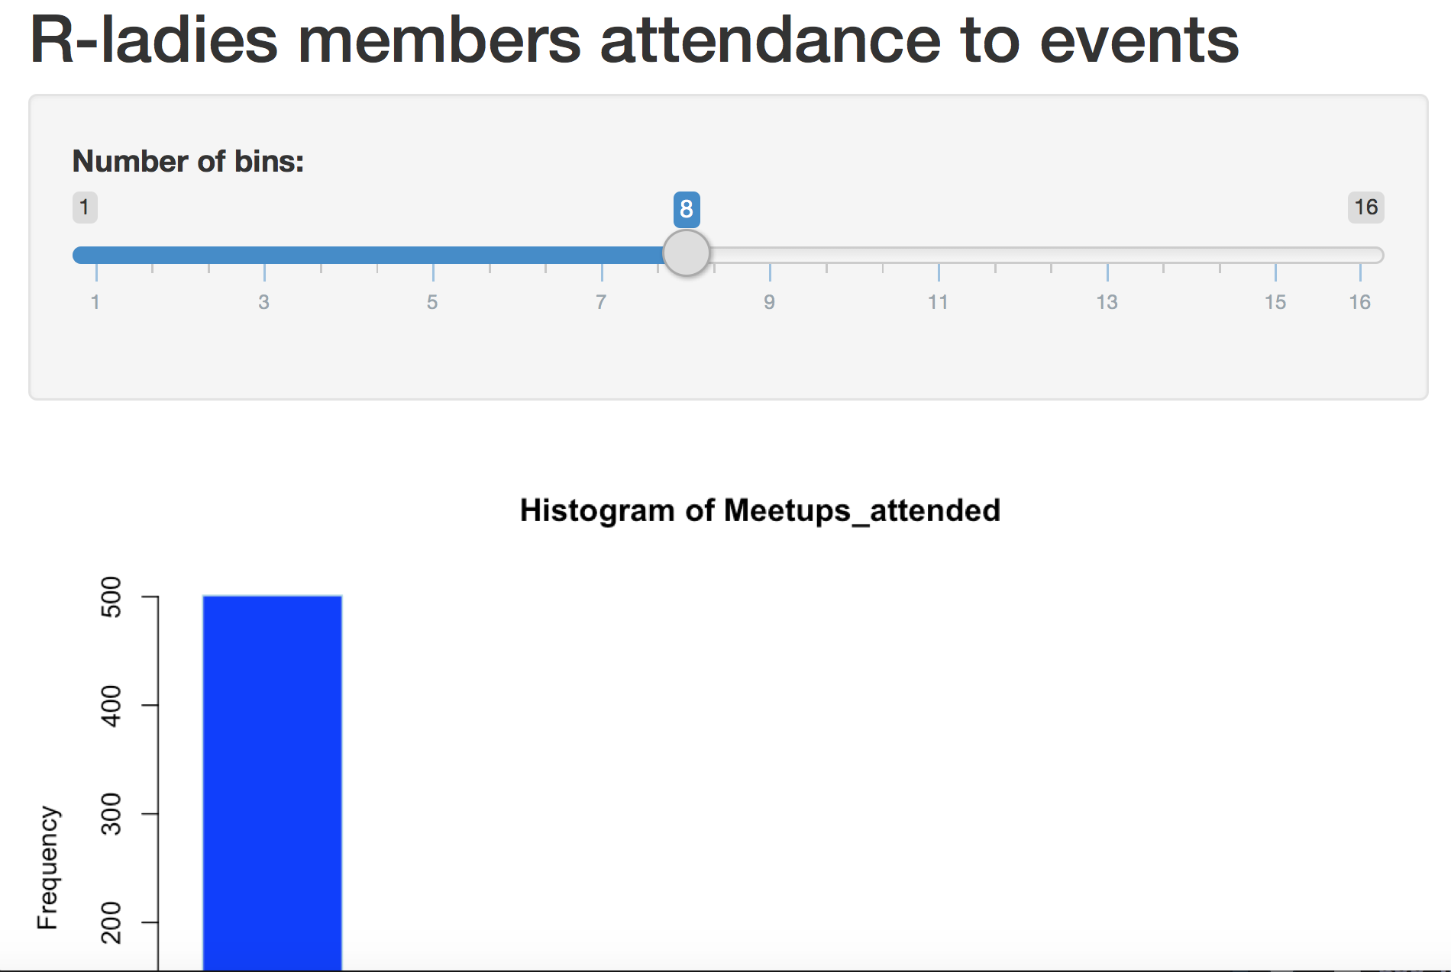
First exercise: Create your own app

Slide 19
First exercise: Create your own app
Modify the application to plot the distribution of Rladies Melbourne members attendance:
Change the title of the panel to: " R-ladies members attendance to events”.
Change the maximum number of bins to 16.
Change the default bin value to 8.
Load a different dataset to plot the distribution Members attendance to Meetups (file to load is: Members_attendance.txt)
Change the color of the histogram to blue and border to lightblue

Slide 20
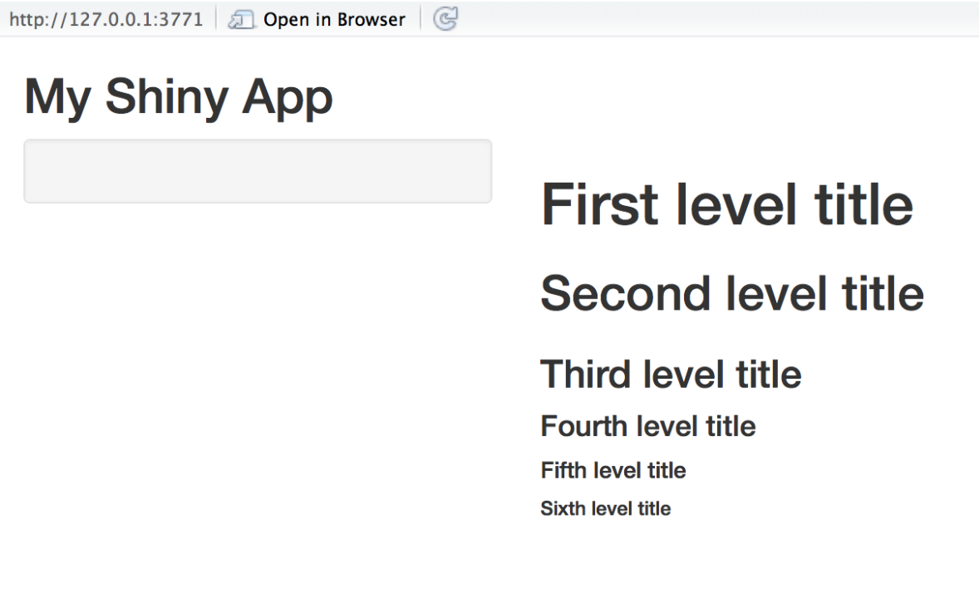
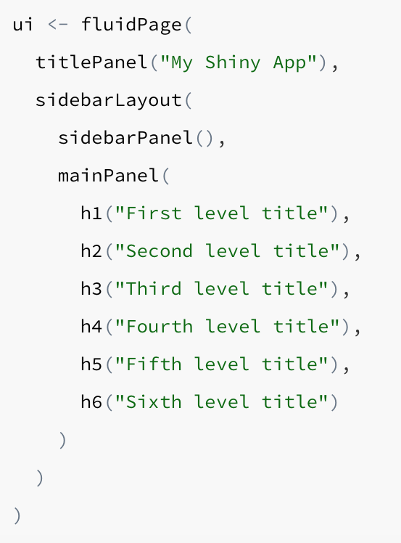
Adding some text

Slide 21
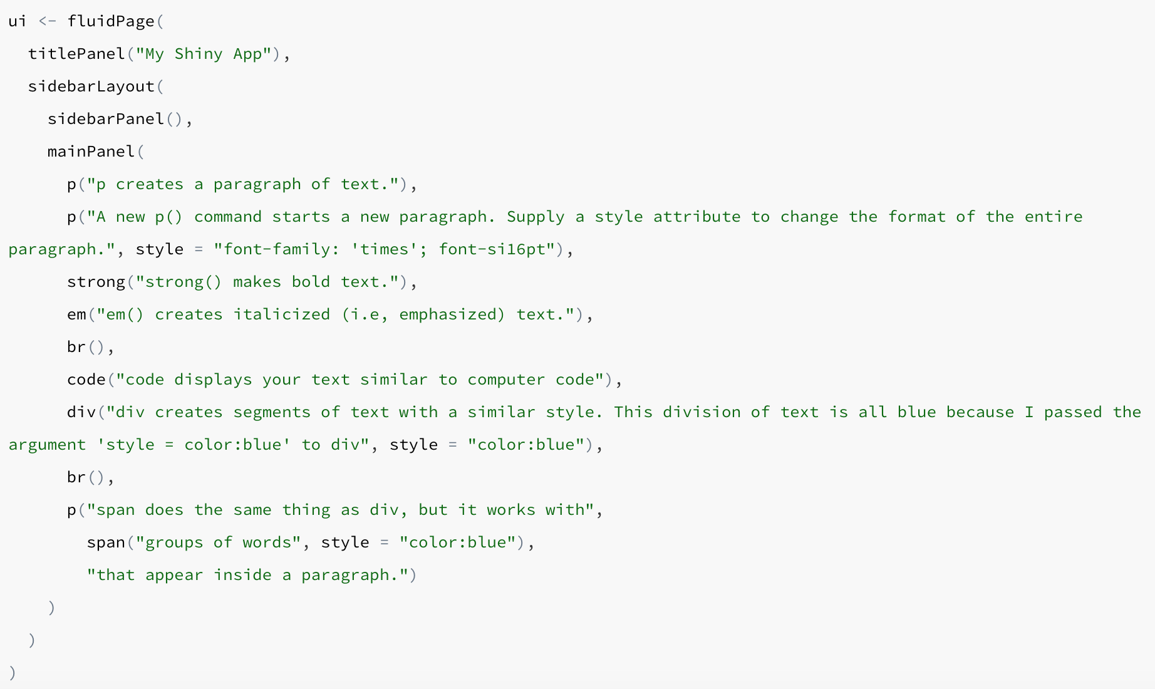
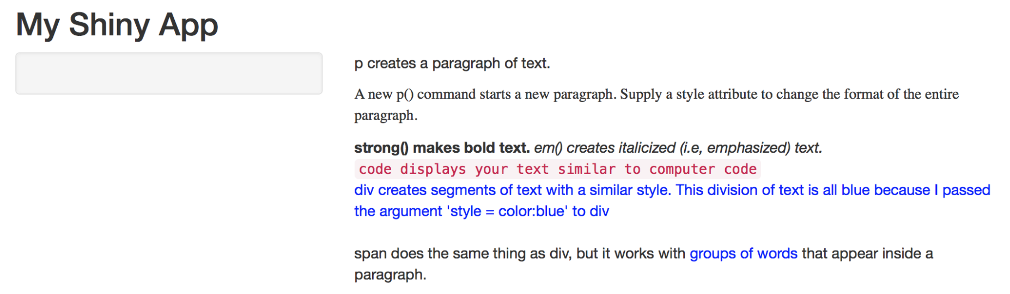
GO further

Slide 22
First exercise: create your own app
Modify the application to plot the distribution of Rladies Melbourne members attendance:
Change the title of the panel to: " R-ladies members attendance to events”.
Change the maximum number of bins to 16.
Change the default bin value to 8.
Load a different dataset to plot the distribution Members attendance to Meetups (file to load is: Members_attendance.txt)
Change the color of the histogram to blue and border to lightblue
Add some text to explain what we are plotting

Slide 23
Inputs in R shiny APP
Slider input: User can specify a slide range rather than a single value.
Numeric input: User can specify a numeric value.
Text input: User can write in a free form text box.
Select input: User can select a value from a specified list.
Checkbox input: User can check a box to indicate an option.

Slide 24
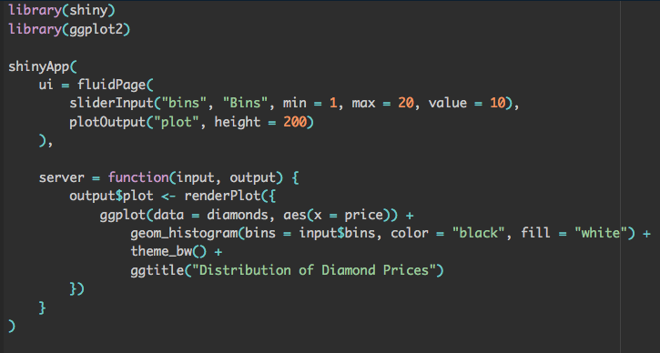
Inputs in R shiny APP
Slider input: User can specify a slide range rather than a single value.
app_with_slider.R

Slide 25
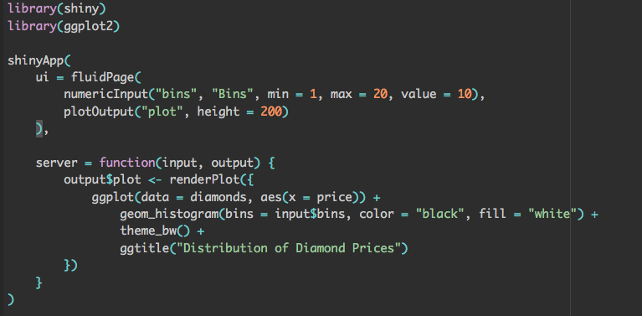
Inputs in R shiny APP
Numeric input: User can specify a numeric value.
app_with_numeric.R

Slide 26
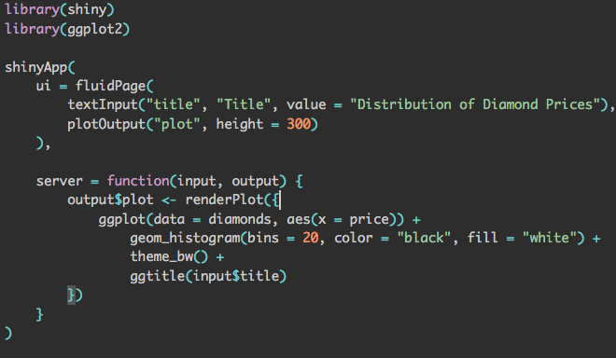
Inputs in R shiny APP
Text input: User can write in a free form text box.
app_with_text.R

Slide 27
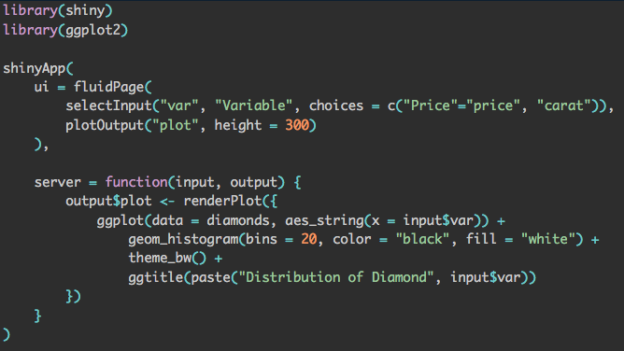
Inputs in R shiny APP
Select input: User can select a value from a specified list.
app_with_select.R

Slide 28
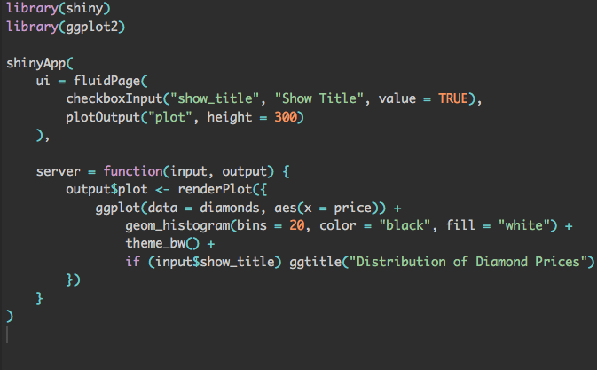
Inputs in R shiny APP
Checkbox input: User can check a box to indicate an option.
app_with_checkbox.R

Slide 29
Outputs in R shiny app
Plot input: display a plot (regular or ggplot2).
Table input: display R data frame or matrix into a html table.
Data Table input: display R data frame or matrix into a fancy searchable html table.
Text input: display text with no formatting.

Slide 30
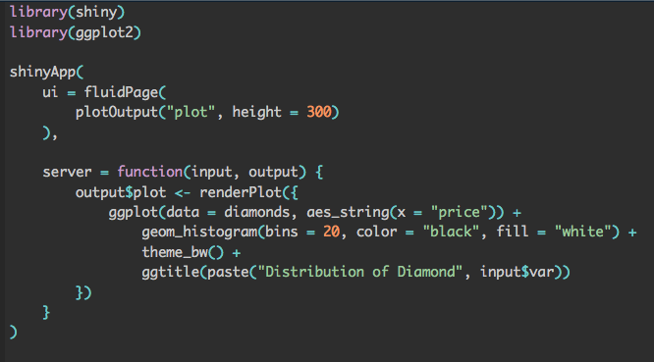
Outputs in R shiny app
Plot input: display a plot (regular or ggplot2).
app_with_plot.R

Slide 31
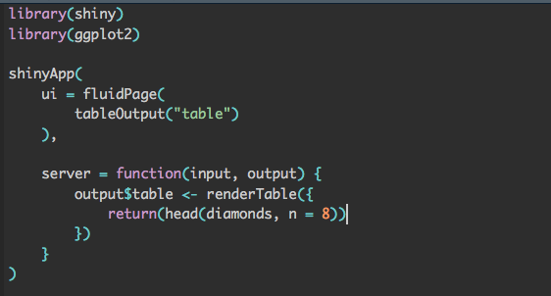
Outputs in R shiny app
Table input: display R data frame or matrix into a html table.
app_with_table.R

Slide 32
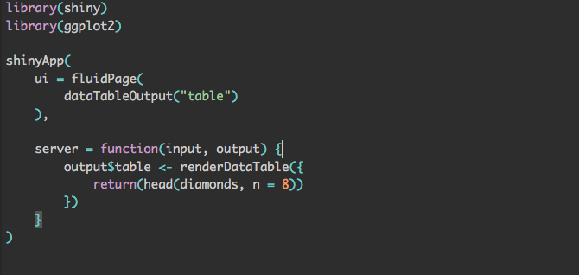
Outputs in R shiny app
Data Table input: display R data frame or matrix into a fancy searchable html table.
app_with_datatable.R

Slide 33
Outputs in R shiny app
Text input: display text with no formatting.
app_with_text.R

Slide 34
Second exercise: Inputs and Outputs
Modify the application:
Change the title so that you can modify it as a text input.
Add a numeric input for the bin value instead of a slider.
Add a datatable with the file (file to load is: Members_attendance.txt)

Slide 35
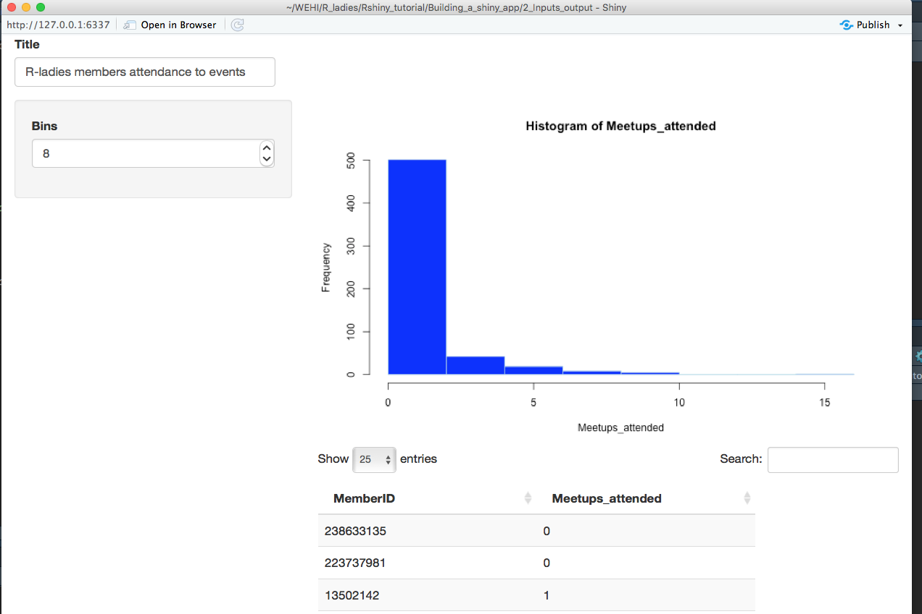
Second exercise: Inputs and Outputs

Slide 36
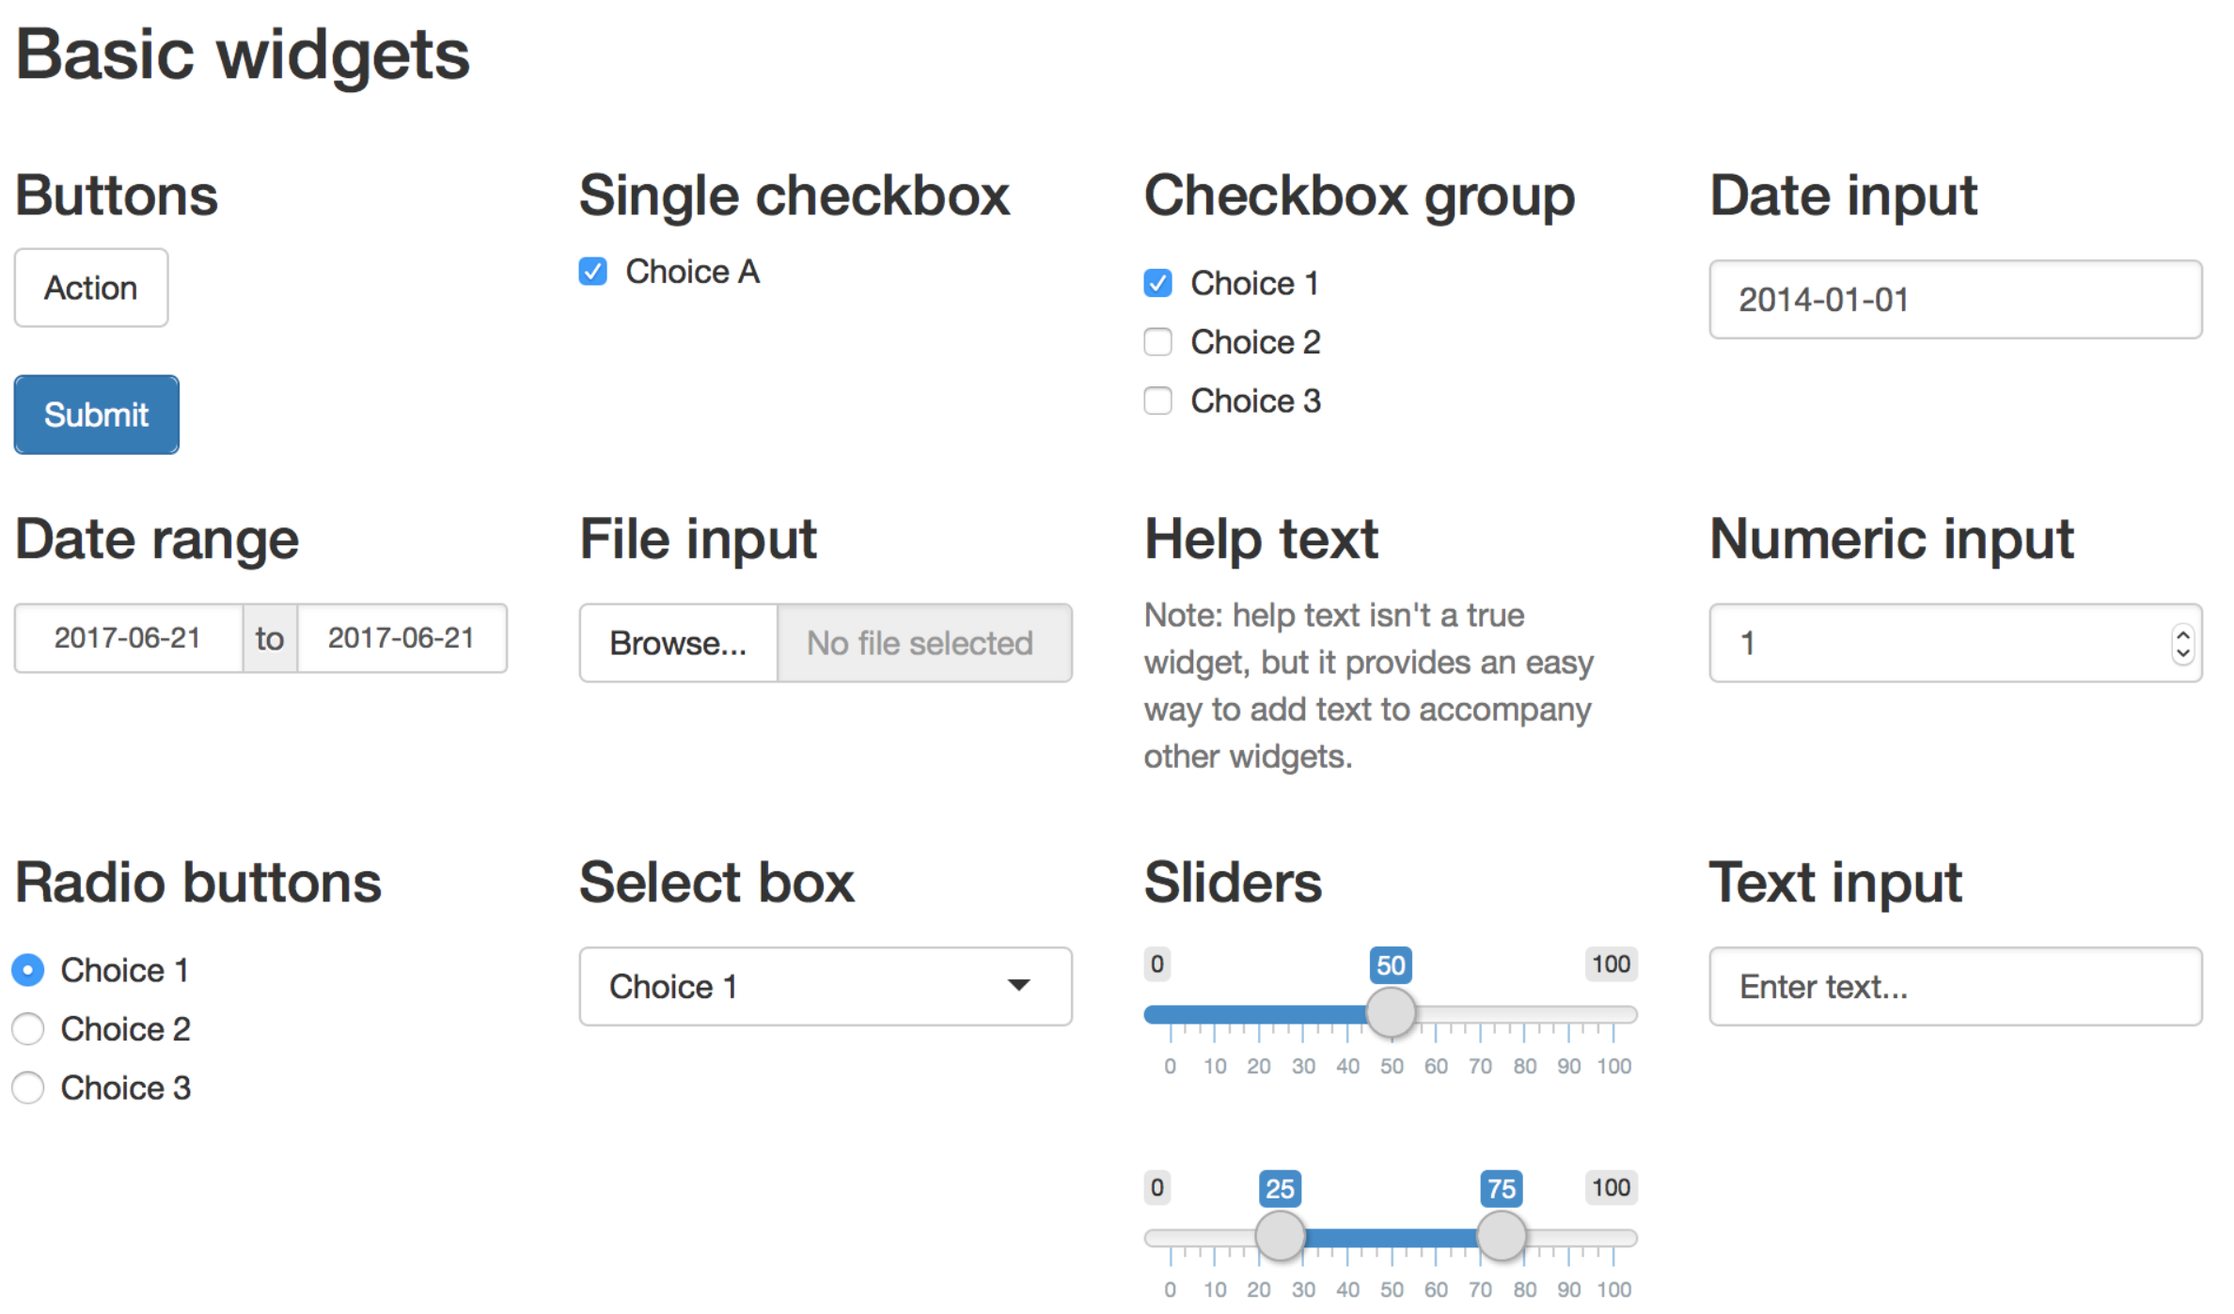
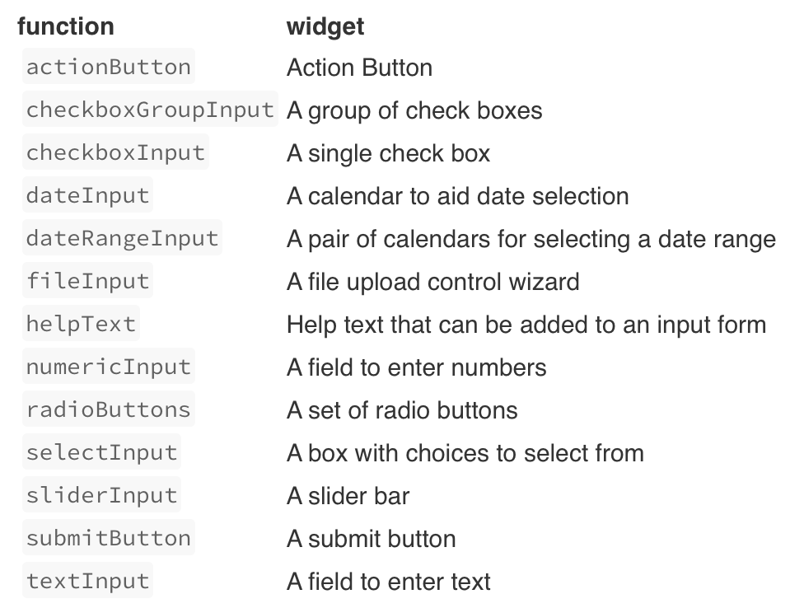
Recap

Slide 37
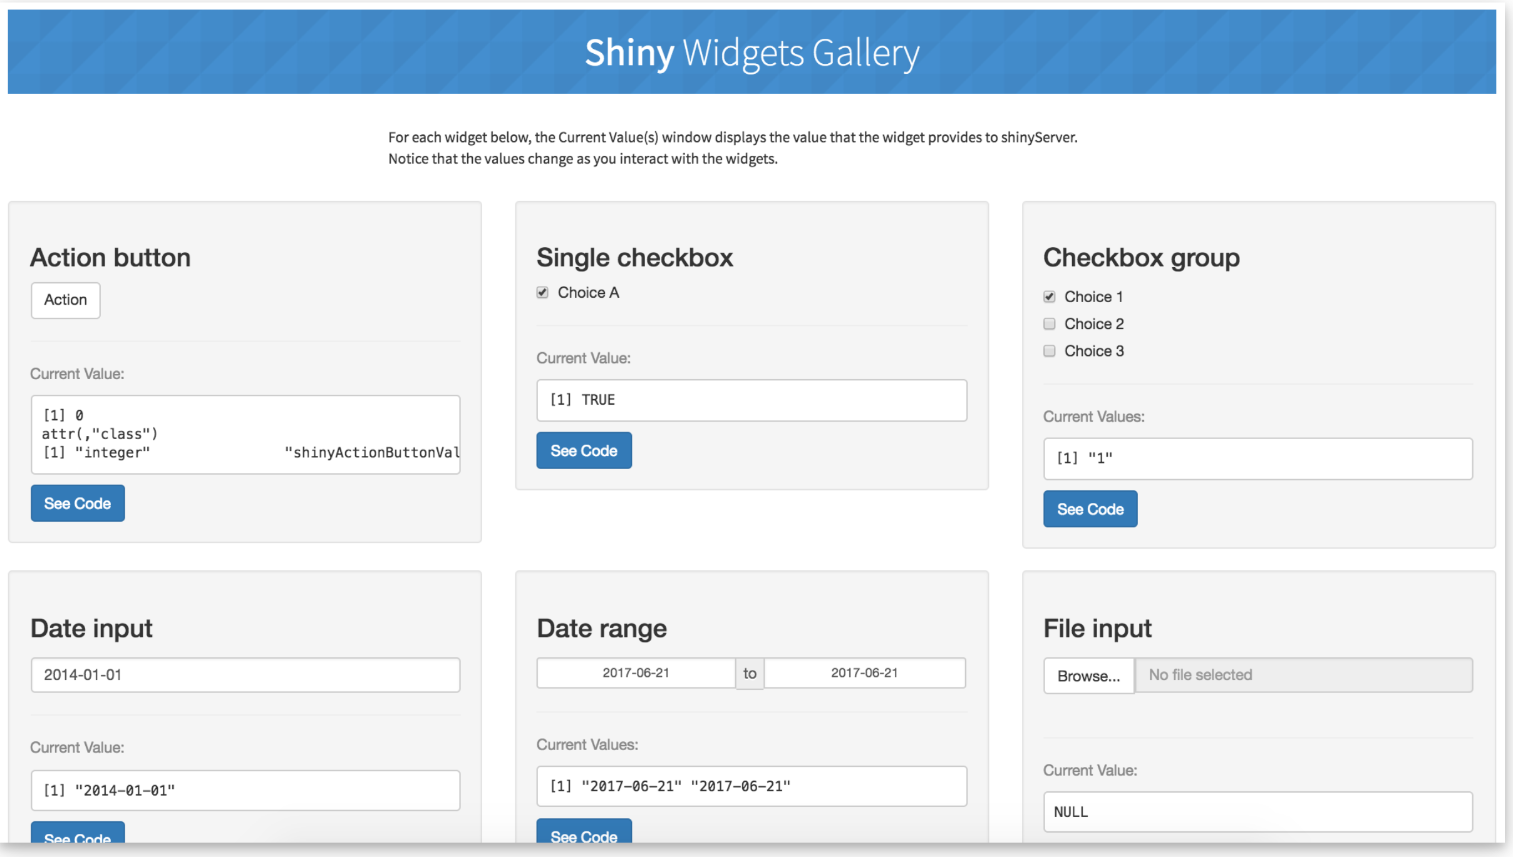
Recap

Slide 38
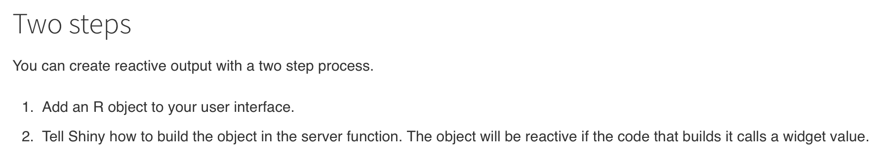
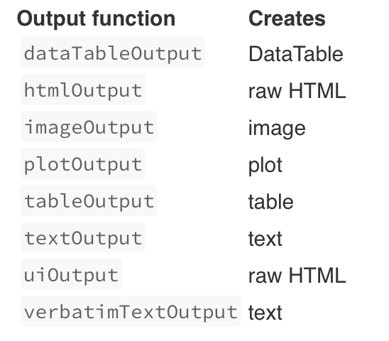
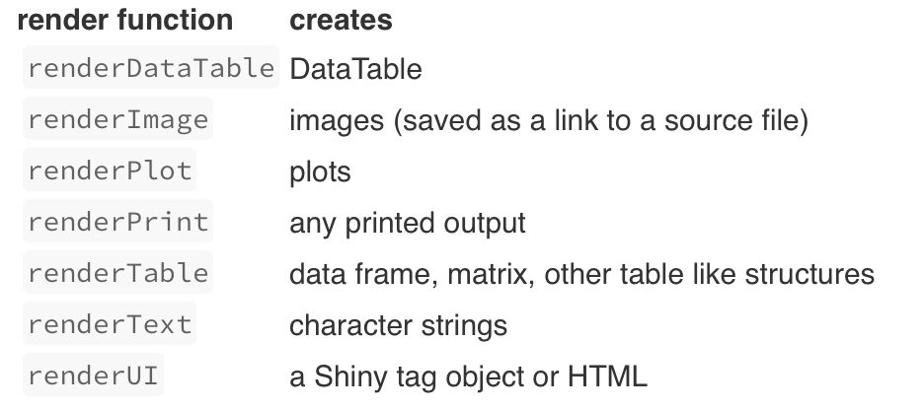
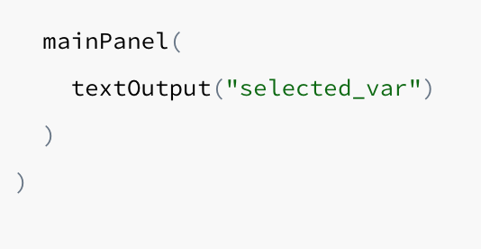
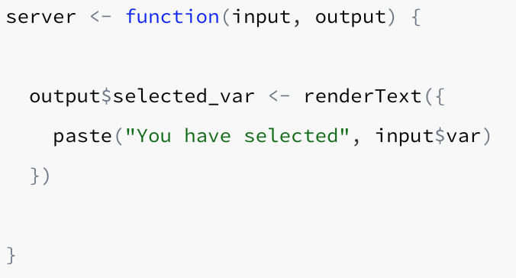
Recap
in “ui” body
in “server” body

Slide 39
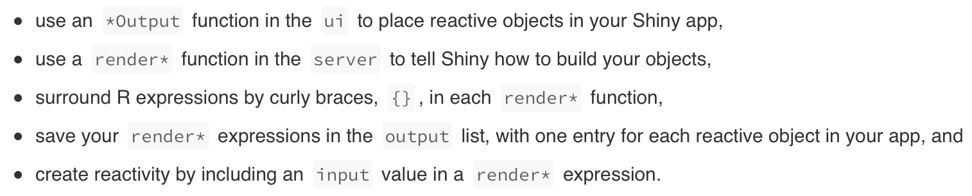
Recap

Slide 40
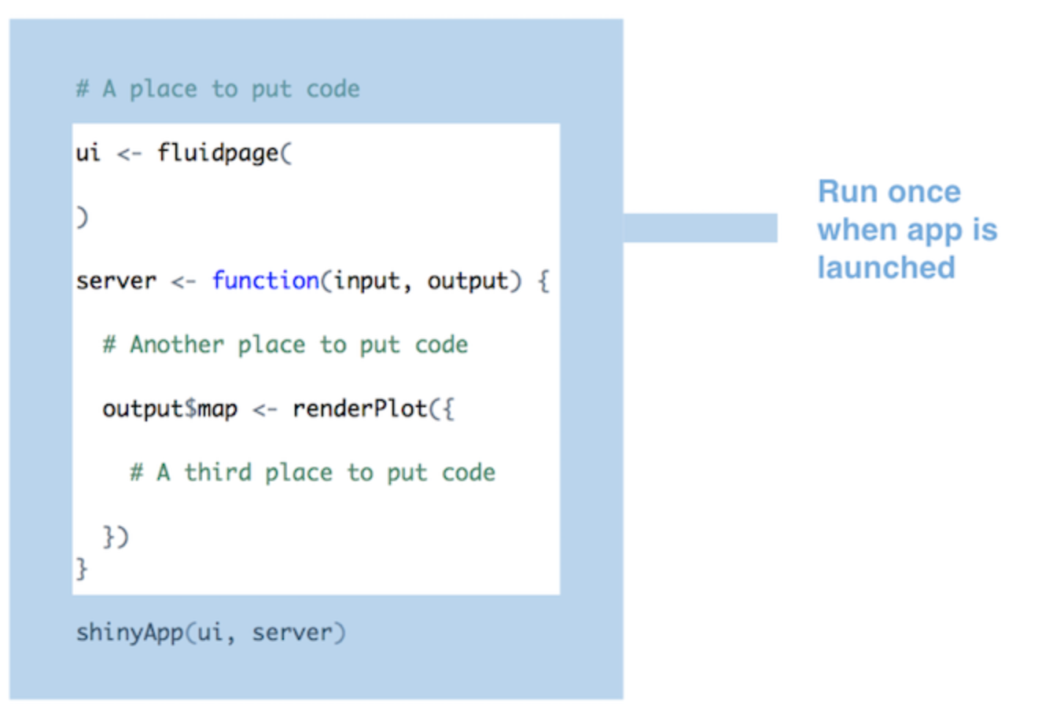
Execution

Slide 41
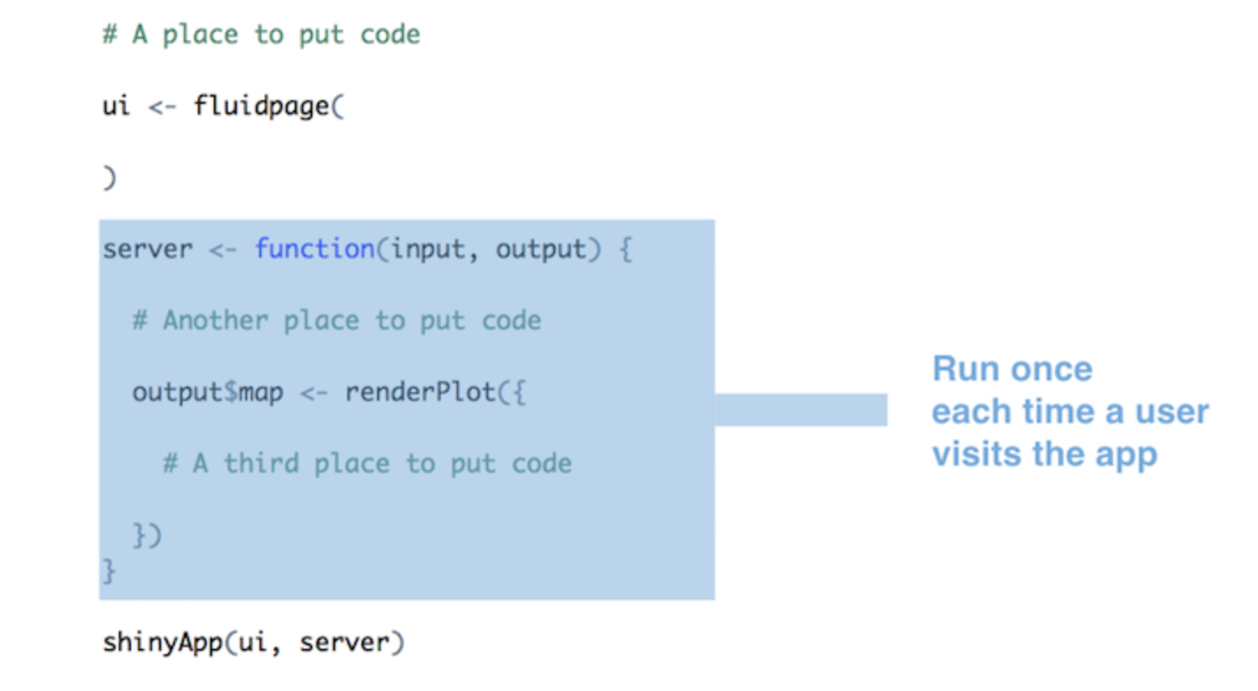
Execution

Slide 42
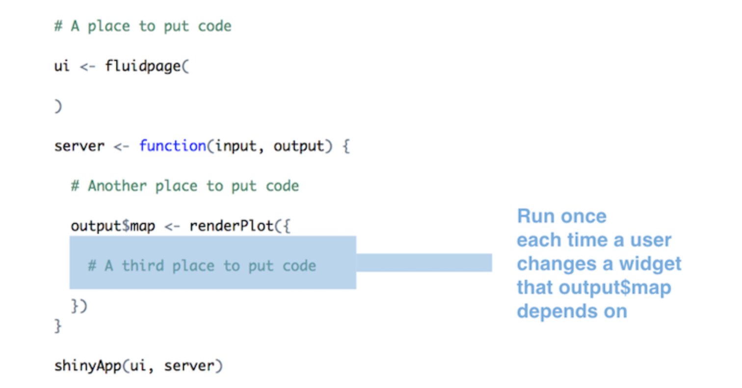
Execution

Slide 43
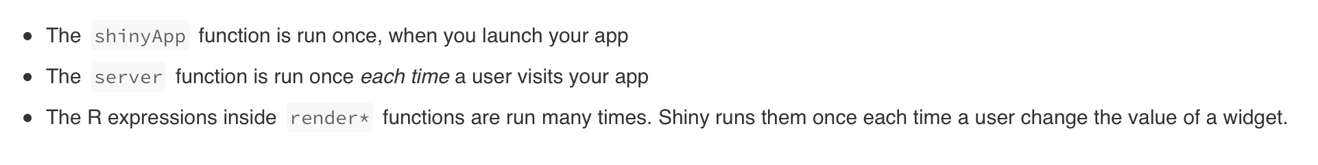
Execution

Slide 44
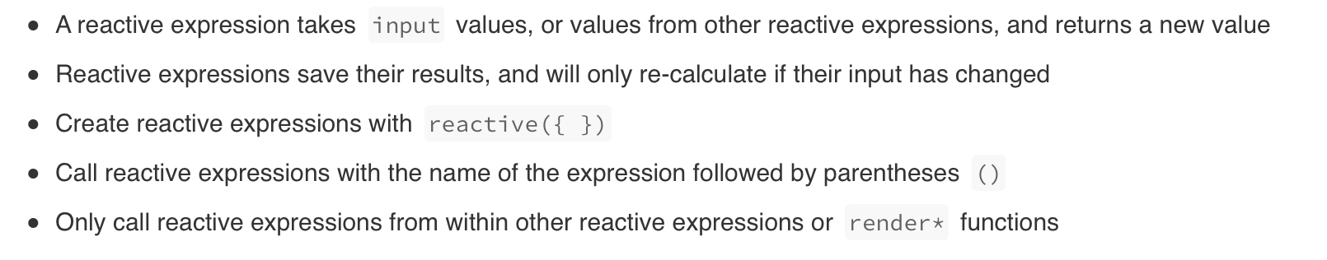
Reactive expressions

Slide 45
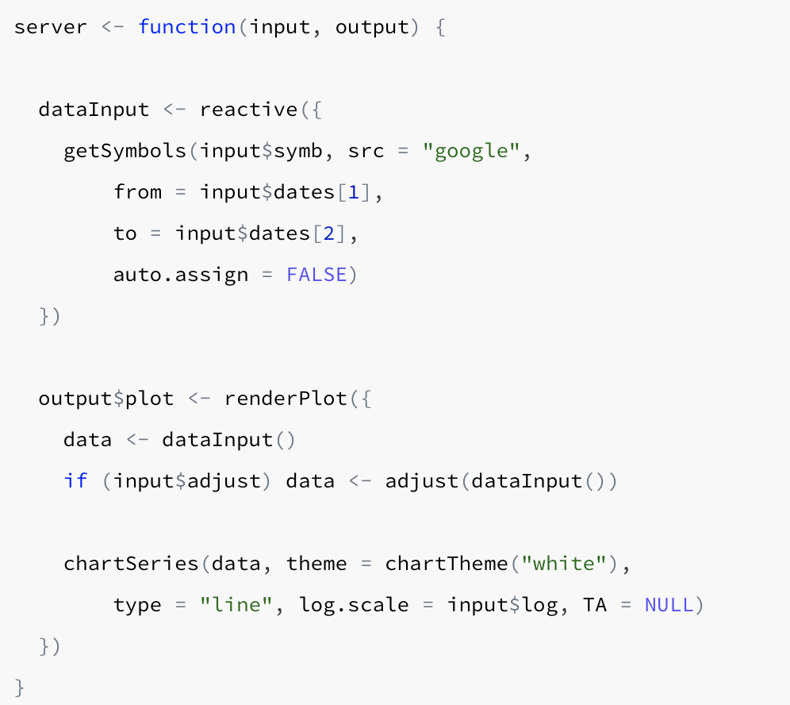
Reactive Expressions - Example

Slide 46
Third Exercise: Reactivity
Let’s revisit Exercise 2:
Place a drop-down menu in the sidebar panel to let the user to select which datasets they want to display between the ‘meetup attendance’ data and the ‘diamonds’ data as a table.
The table underneath the histogram should change based on the dataset selected

Slide 47
Summary
Shiny is an great tool to build interactive web apps from R and easy to learn!
How to build your first Shiny app
How to add differents inputs/ouputs
How to add reactivity
How to deploy your app on a server

Slide 48
Further reading material
Ideas and examples: https://shiny.rstudio.com/gallery/
Videos tutorials:
https://shiny.rstudio.com/tutorial/
Widgets: https://shiny.rstudio.com/gallery/widget-gallery.html
More advanced shiny tutorial next year in Rladies!

